Slide 1
IELTS
GENERAL WRITING TASK 1

Slide 2
INVITATION LETTER
1. Dear Sir/Madam, (or name if given)
2. Explanation: 1-2 sentences what you are inviting
  I am writing to invite you to …. (formal)
  How have you been since we last met? I thought I’d drop you a line and see if you fancy + V-ing (informal)
  I am writing to inform you about …... And I would like to take this opportunity to invite you to join/ take part in this very meeting/ party/ conference.
  I am writing to extend my invitation to you regarding to a meeting session which takes place in….
  As a regular and valued customer of ours, we would very much like you and a guest to be present on this special occasion for us.

Slide 3
INVITATION LETTER
3. Explain and describe why to join/ accept the invitation.
  This party/ meeting will definitely be a good reason to meet (informal – formal)
  The party/ meeting includes/ contains …, which I’m sure you’ll love.
  The party/ meeting includes/ contains ….,
  The meeting will assuredly provide a considerable amount of useful information that largely contributes to your future endeavors. (Mời hội thảo/ workshop/ training)

Slide 4
INVITATION LETTER
4. Say how important the person’s presence is
  I really hope you’ll be able to come over/ drop by. It won’t be the same without you. (informal)
  We will be glad and honored to have you participate in the …. Your presence is of paramount importance to the success of the ….
5. Giving direction
However, if you have any difficulty in finding my address, just call me. I will send my cousin for your help. See you at the party then. (informal)
Here is the direction of the training/ my house (nếu muốn chỉ đường)

Slide 5
INVITATION LETTER
In the meantime, please do let me know if you need any additional information.
Please bring the enclosed invitation to show at the door and please call or e-mail us if you have any special requests for the evening.
Formal ending, name, signature
  I look forward to receiving a prompt reply!
  We look forward to sharing the special evening with you.
  Yours sincerely, ... (you know the name of person you are writing to)
  Yours faithfully, ... (you don't know the name!)

Slide 6
REQUEST LETTER
Formal ending, name, signature
  Informal: All the best
  See you soon
  Keep in touch

Slide 7
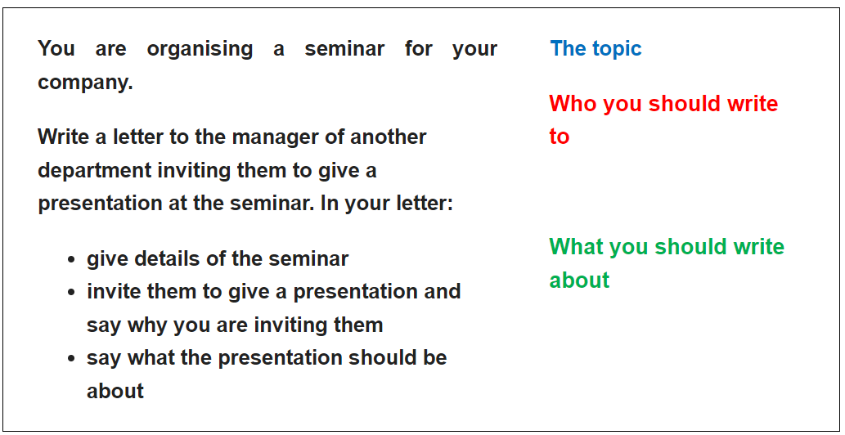

Slide 8
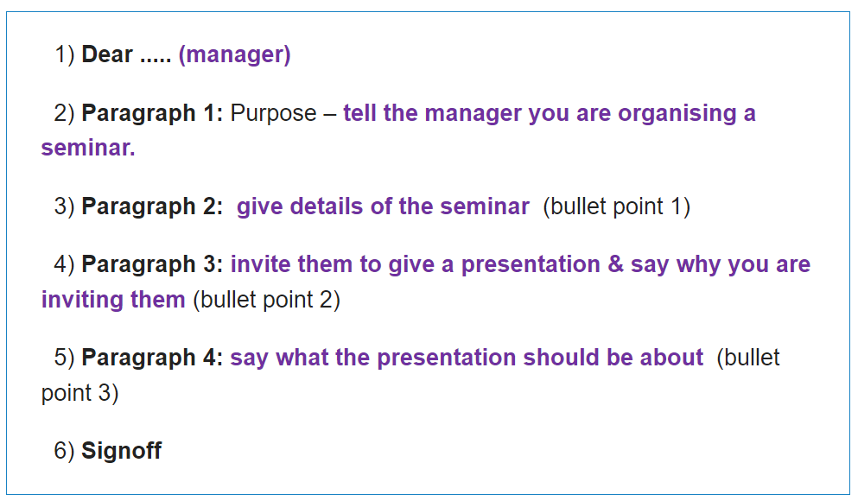

Slide 9
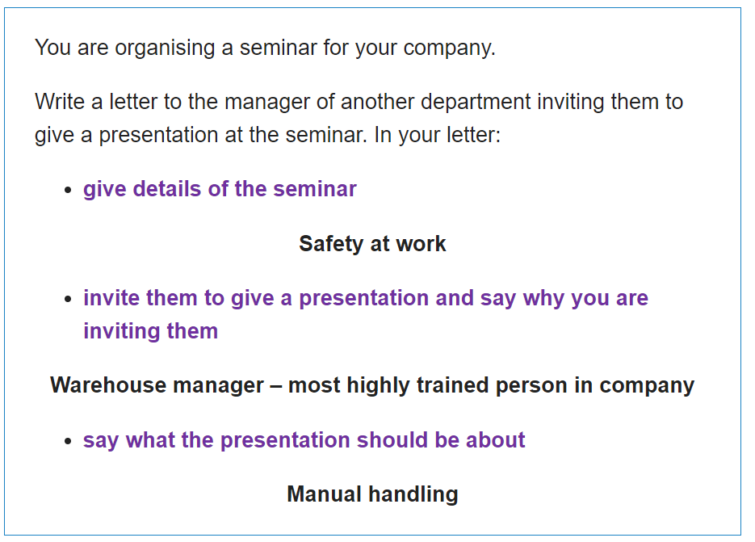

Slide 10
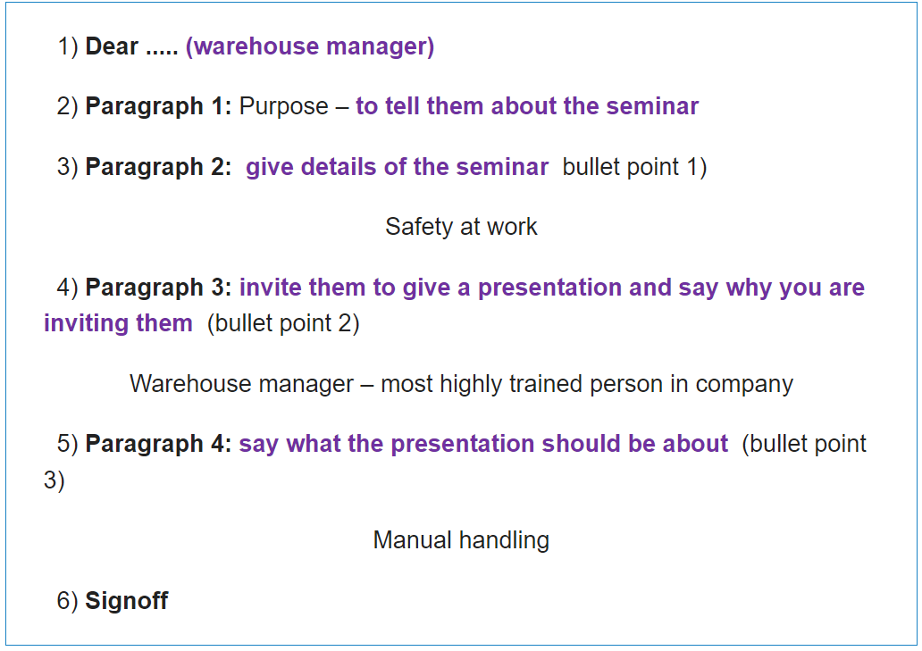

Slide 11
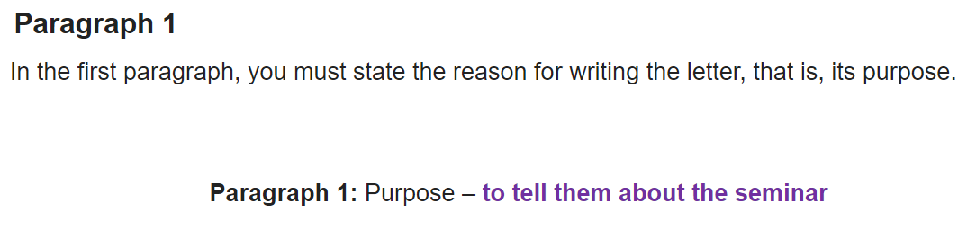
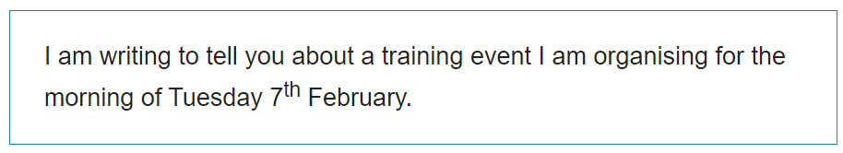
  I am writing to invite you to …. (formal)
  How have you been since we last met? I thought I’d drop you a line and see if you fancy + V-ing (informal)
  I am writing to inform you about …... And I would like to take this opportunity to invite you to join/ take part in this very meeting/ party/ conference. (formal)
  I am writing to extend my invitation to you regarding to a meeting session which takes place in….
And I would like to take this opportunity to invite you to join/ take part in this very meeting/ party/ conference/ workshop.

Slide 12
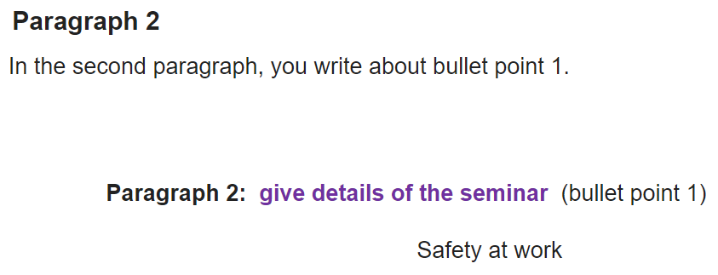
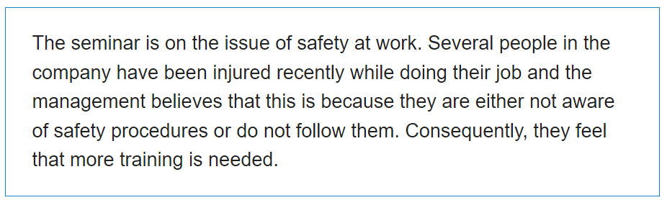
  Sau khi nói chi tiết thì kết luận:
  This party/ meeting will definitely be a good reason to … (informal – formal)
  The party/ meeting includes/ contains …, which I’m sure you’ll love.
  The party/ meeting includes/ contains ….,
  The meeting/ workshop will assuredly provide a considerable amount of useful information that largely contributes to your future endeavors. (Mời hội thảo/ workshop/ training)
To explain in more detail, …

Slide 13
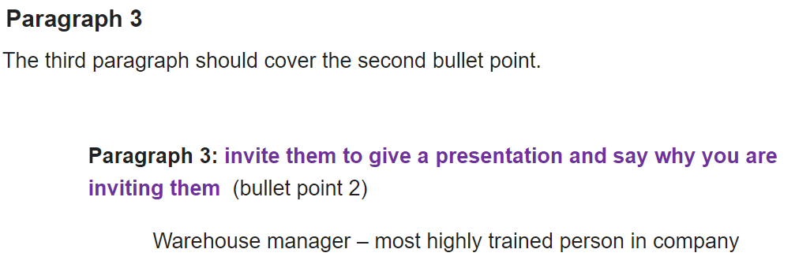
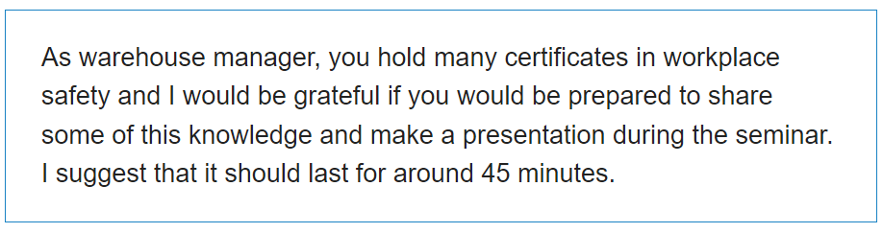
  I really hope you’ll be able to come over/ drop by. It won’t be the same without you. (informal)
  We will be glad and honored to have you participate in the committee meeting. Your presence is of paramount importance to the success of the committee meeting.

Slide 14
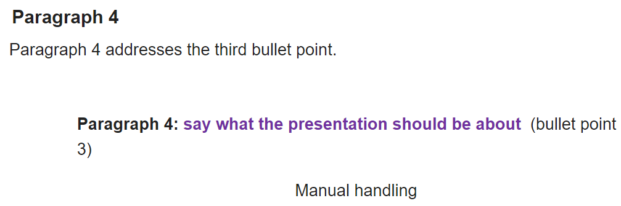
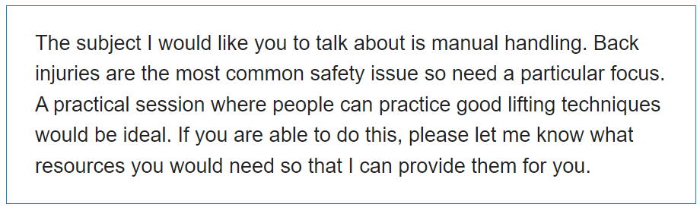

Slide 15
Dear Sir/Madam,
I am writing to inform you about a workshop I am organizing. And I would like to take this opportunity to invite you to take part in this very seminar/ wedding ceremony.
In a little more detail, (đưa chi tiết về seminar). The workshop will assuredly provide a considerable amount of useful information that largely contributes to work of the staff in our company.
We would very much like you to make a presentation/ share your knowledge in the workshop. We will be glad and honored to have you participate in the workshop. Your presence is of paramount importance to the success of the workshop.
The presentation will be about (đưa chi tiết về presentation).
In the meantime, please do let me know if you need any additional information. I look forward to receiving a prompt reply!
Your sincerely,
Nhan

Slide 16
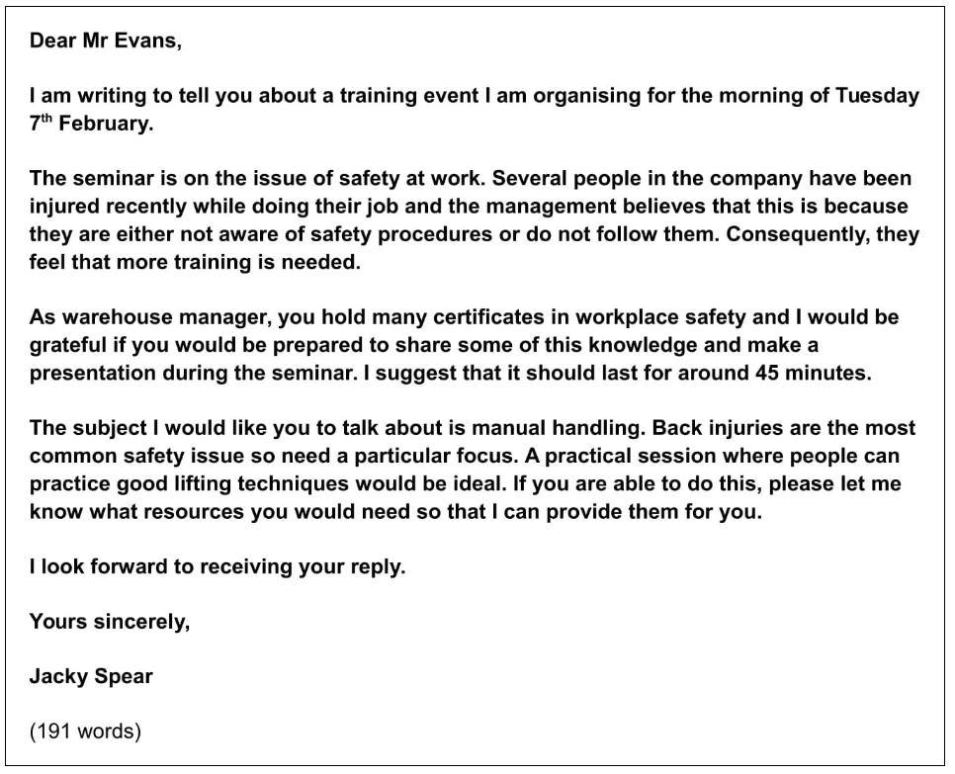

Slide 17
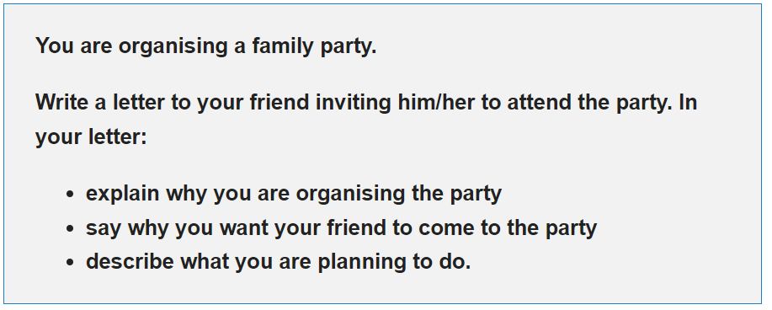

Slide 18
